Slide 1
TOUCH SCREEN FM RADIO
BY ANISH AND SAHANA

Slide 2
FEATURES OF THE PROTOTYPE
Can tune to a desired frequency
Interactive display
Touch screen interface
Can be easily interfaced with Arduino Boards, Raspberry Pi and Microcontrollers via I2C interface.

Slide 3
Components of FM Module
Single chip- Electronically tunes stereo FM radio for low voltage applications
Fully integrated Intermediate Frequency (IF) selectivity and FM demodulator.
Minimum external components- completely adjustment free

Slide 4
COMPONENTS USED FOR BUILIDING THIS PROTOTYPE
TFT LCD Screen(3.5 inches)
TEA5767 module
Arduino Uno
Earphones
Jumper Cables
Purf board
Cardbboard Box
Paint

Slide 5
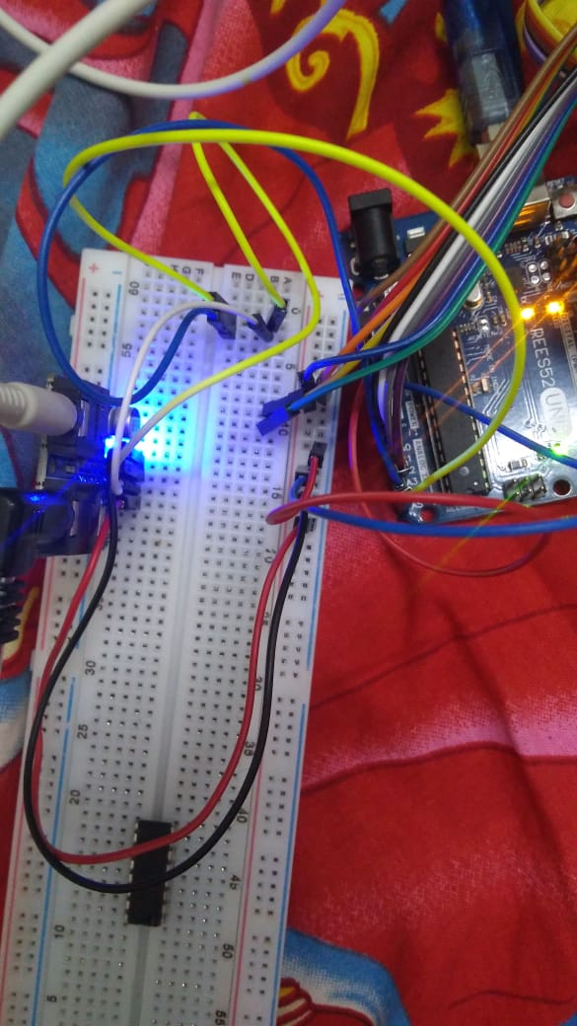
CIRCUIT CONNECTIONS

Slide 6
The code
testing\fm_radiofinal\fm_radiofinal.ino

Slide 7
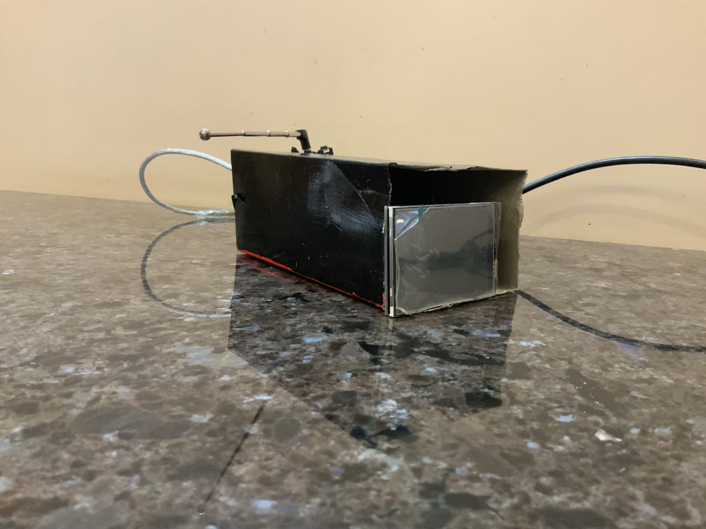
FINAL MODEL

Slide 8
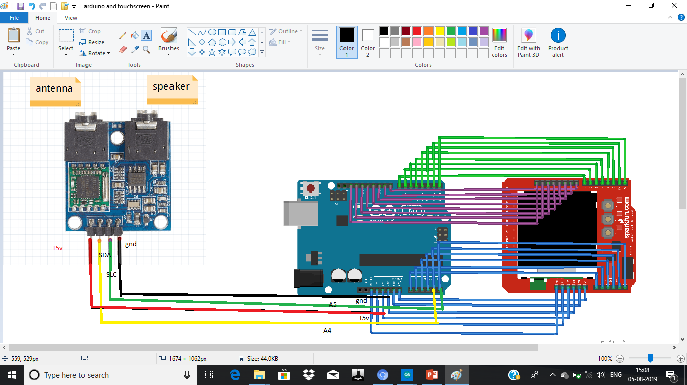


Circuit diagram

Slide 9
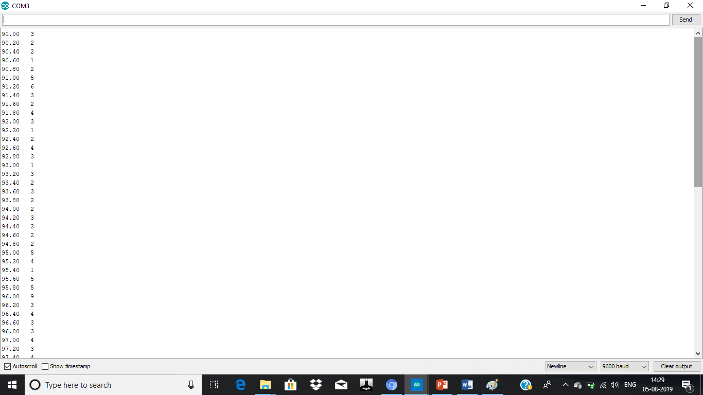
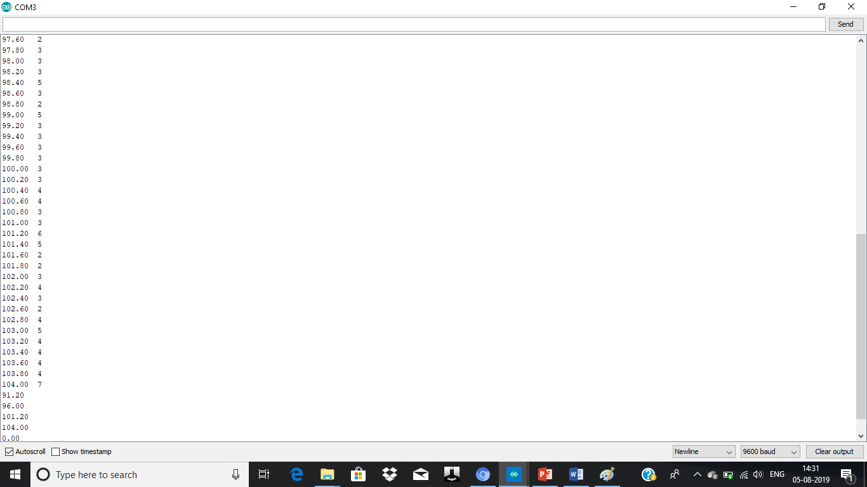
Serialmonitor values

Slide 10
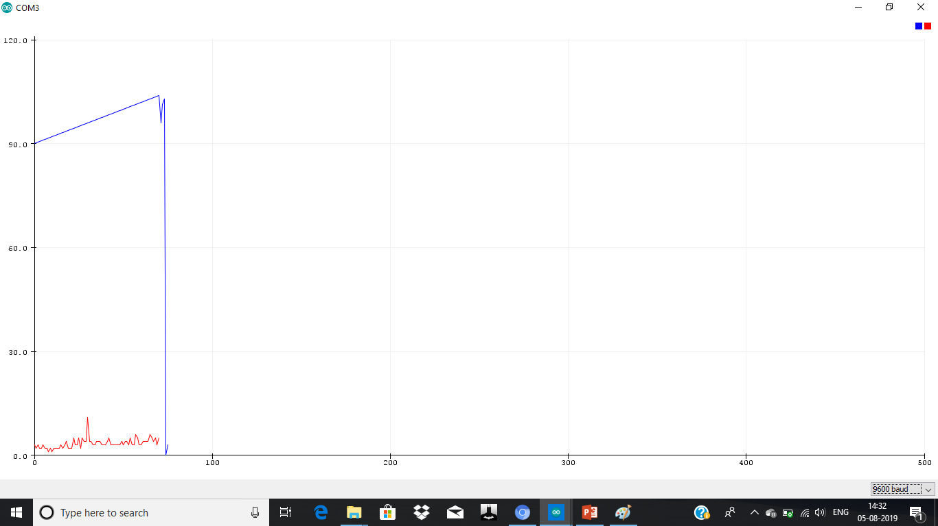
Serialplotter values

